Slide 2
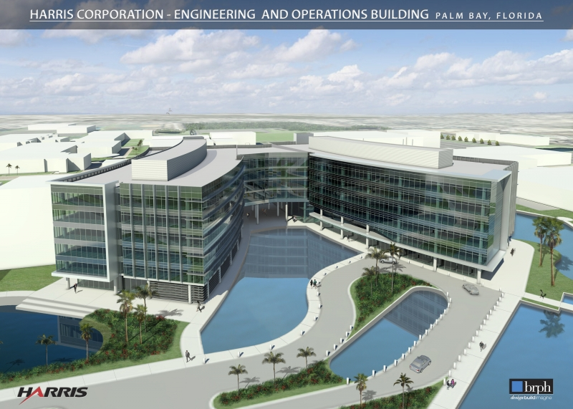

About Harris
Trusted partner to global ATM community for more than 25 years
Headquartered in Melbourne, Florida
Over 15,000 employees
  Including 6,000 engineers and scientists
Approximately $5.1 billion annual revenue
  With nearly $1 billion invested in Engineering R&D
200+ customers in 125+ countries on 6 continents
Our mission is to be the best-in-class provider of mission critical assured communications® products, systems and services
for global markets

Slide 3
FAA NextGen Programs
Harris Plays Major Roles
NEMS/DEX
DataCom
ADS-B
NVS
Weather
Other
NextGen Programs
Harris NEMS/DEX
SOA / SWIM Delivery Mechanism
FTI
One Transport Network
Notes:
Other Programs such as Systems Engineering 2020 (SE2020), Unmanned Aerial Vehicle (UAV)

Slide 4
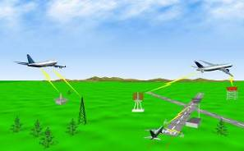
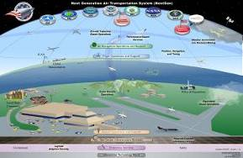
FAA NextGen Programs
Harris Helping FAA Move Forward
Today’s National Airspace System
NextGen
Air Traffic “Control”
Ground-based Navigation and Surveillance
Air Traffic Control Communications By Voice
Disconnected Information Systems
Fragmented Weather Forecasting
TDM-based Voice Switching
Air Traffic “Management”
Satellite-based Navigation & Surveillance (ADS-B)
Routine Information Sent Digitally (DataCom)
Information More Readily Accessible (SWIM)
Forecasts Embedded into Decisions (NNEW)
IP-based NAS Voice Communications System (NVS)

Slide 5
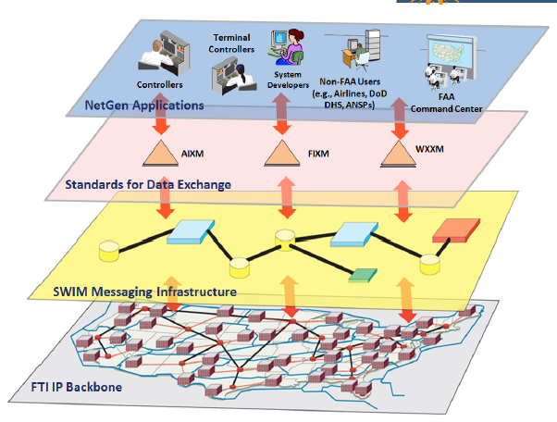
System Wide Information Management (SWIM)
Mission Services:
WARP, Oasis, ERAM, RMLS, etc.
Common Support:
Data Standards &
Harmonization
Enterprise:
SWIM Core Services
I.e. NAS Enterprise Messaging Service (NEMS)
Networks:
FTI & SWIM/NEMS
are the basis for
Network-Centric Operations in FAA
Harris provided NAS Enterprise Messaging Service (NEMS)
is the FAA’s SWIM solution
Notes:
Highlights:
To have a net-centric enterprise, a reliable, high-performance network is necessary
Having the all-digital, ubiquitous network for the FAA (FTI) creates ripe environment for realizing network centric milestones (inclusive of SWIM)

Slide 6

Technology Agnostic by Necessity

Slide 7
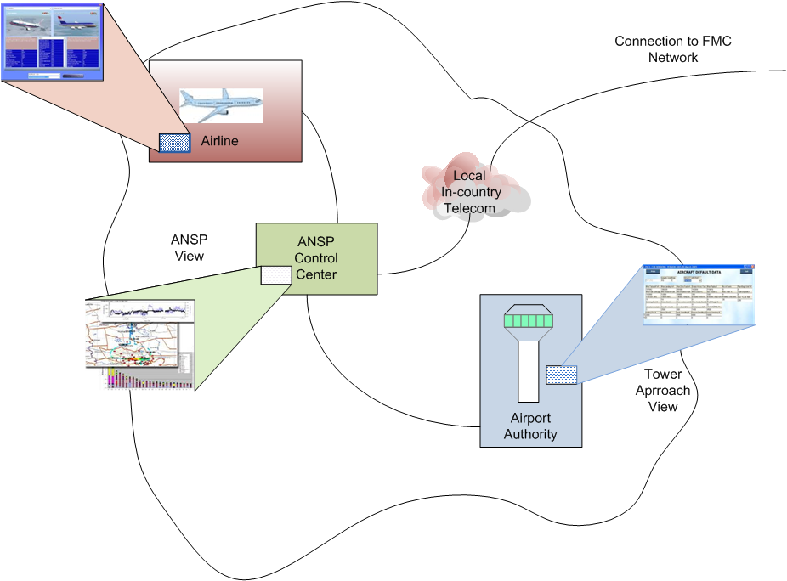
Applications Tailored for each
Country and Customer Requirements

Slide 8
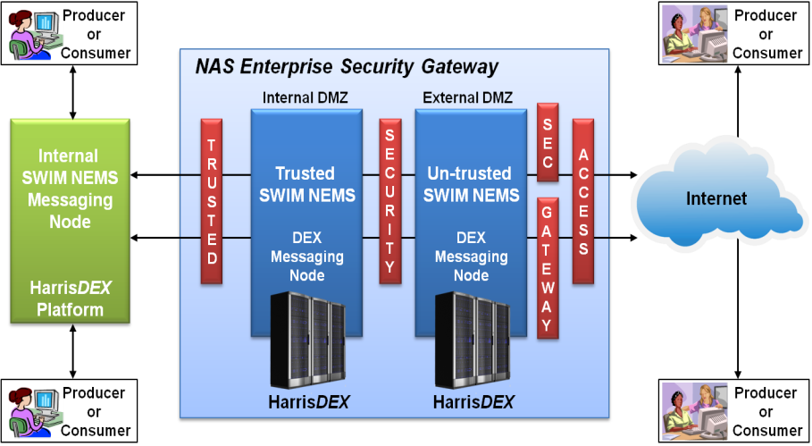
2-Way SOA Gateway
Notes:
One of the important features of the gateway that would be implemented to support the Flow Control Center is the 2-way SOA gateway.
These gateways provides protection for the network and the systems connected to it. Through multiple layers of hardware and software firewall protection, this prevents attacks from the external internet.
However, in the past, putting the systems behind multiple layers of firewalls introduced an issue that would prevent the successful implementation of the Flow Control Center. Information can be published out of the network securely, but the security external entities such as Airlines or other ANSPs to publish back in without creating an entirely separate network.
The differentiator here is that for the Flow Center to be successful, it must be able to support collaboration of information to be shared from the internal system as well as external entities to publish information back into the system.
In the past, for all parties to exchanging information securely, they all were on its own separate network. Using this gateway, authorized external entities such as airlines, and other ANSPs can publish information into the flow control center and enhance the information set available to the control center.
Two examples are:
Airlines that are not a part of the Flow Control Center’s network can still publish their information into the system that can provide addiitional information beyond what is available on AFTN/AMHS.
Capability to subscribe to the web services that is provided by EUROCONTROL to supplement the information available in the Middle East region.
Our capability allows the information to flow securely between internal and external entities.
Do we want to talk about multiple domains possibility here?

Slide 9
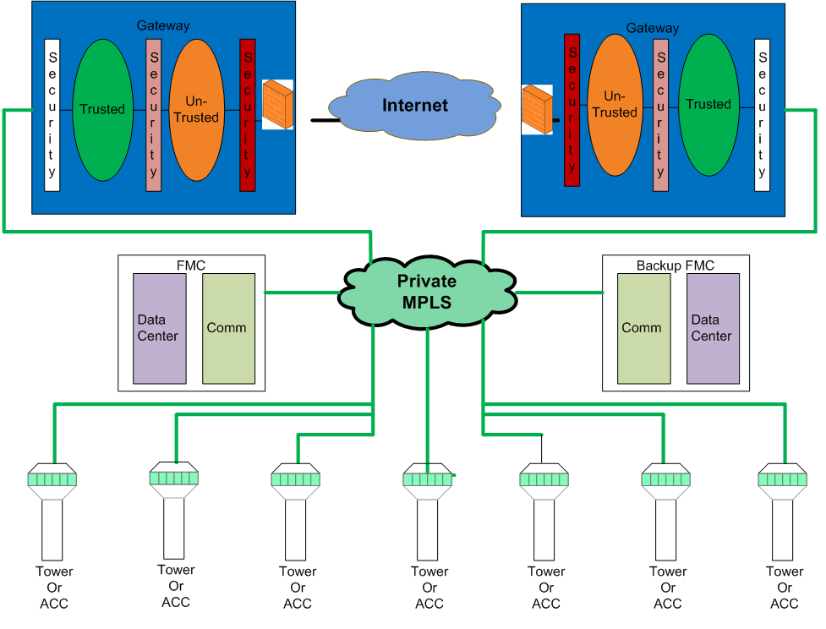
Logical diagram

Slide 10


Harris Corporation...
Where every customer’s program is “Mission Critical.”
Innovation.
Performance.
Anytime.
Anywhere.

